Slide 1
Fairness, Privacy and Transparency by Design for AI/ML systems
Dr. Taufiq Asyhari

Slide 2
Courtesy
Compiled from
P Missier, Transparency in ML and AI, Digital Catapult London, Mar. 2018.
L Albertsson, Privacy by Design, Jfokus, 2018.
N Schmidt, Fairness in AI: How to Identify and Fix Discrimination in Machine Learning, Maryland AI Group, 2019.
P Bennett, et al., Fairness-aware Machine Learning: Practical Challenges and Lessons Learned, WSDM 2019.
A Roth, (Un)fairness in Machine Learning, University of Pennsylvania.
M-A Clinciu and HF Hastie, A Survey of Explainable AI Terminology, Workshop on Interactive Natural Language Technology for XAI, 2019.

Slide 3
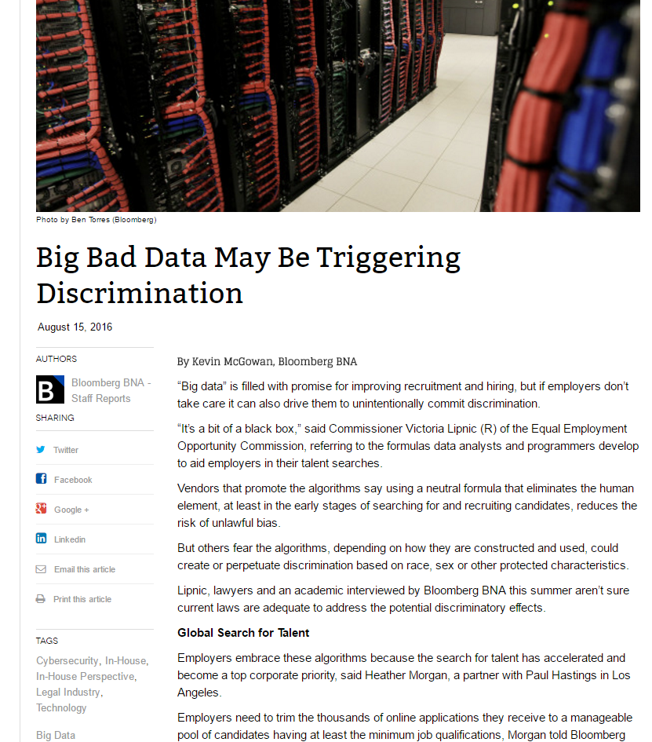
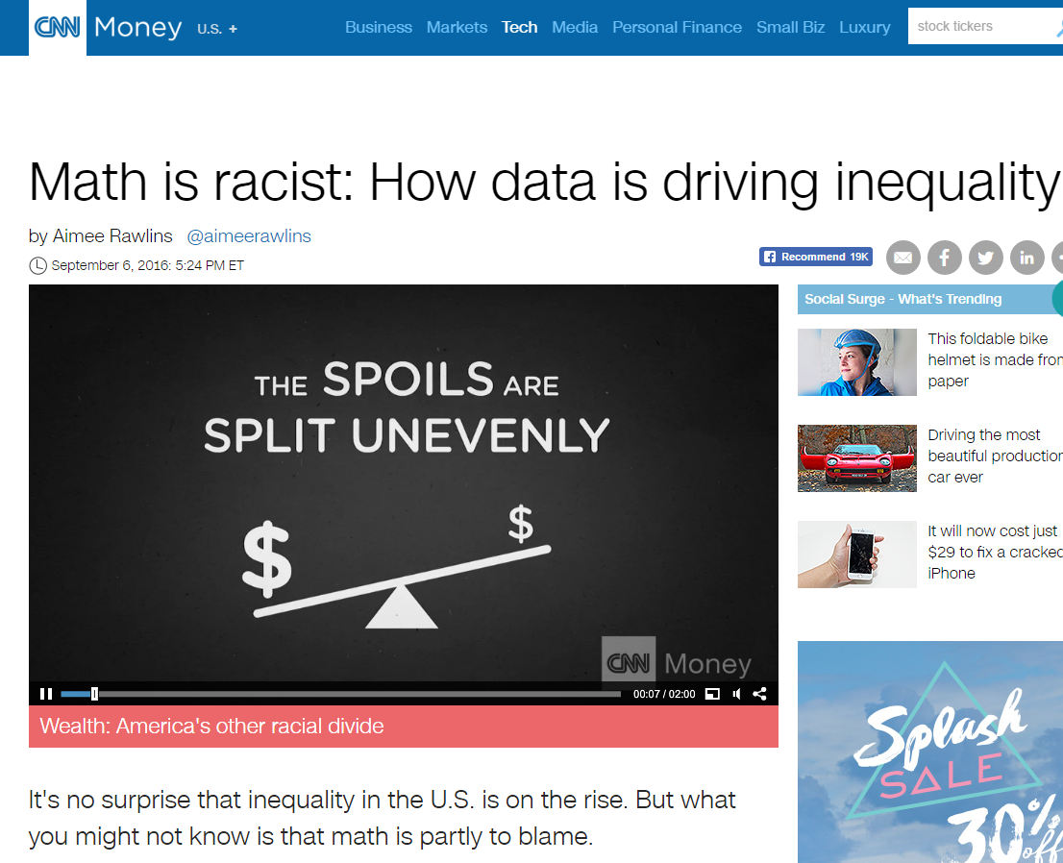
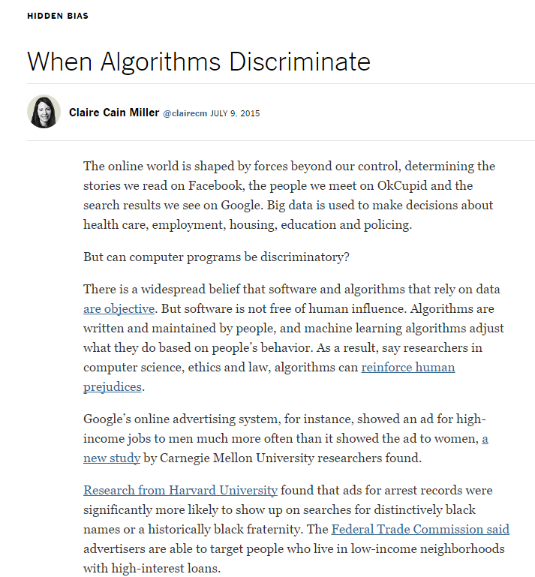
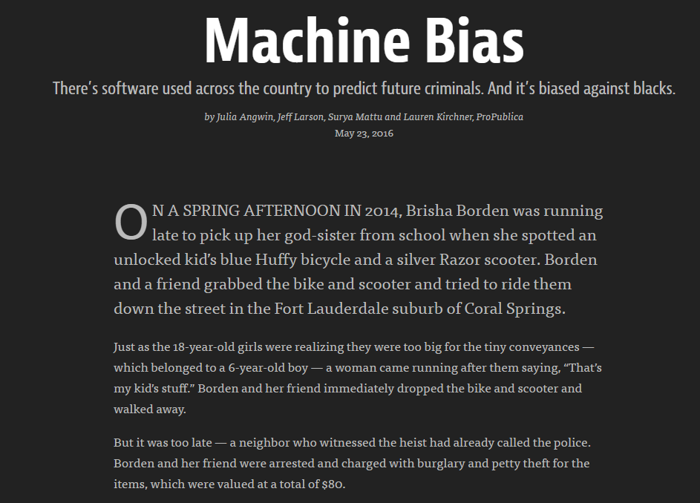

Slide 4
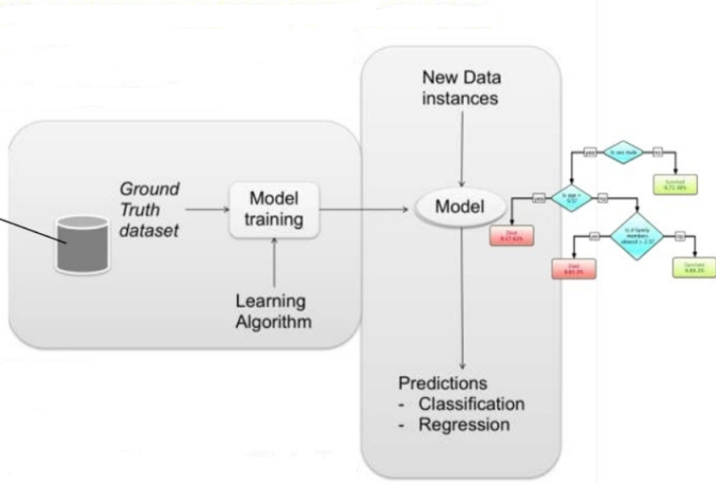
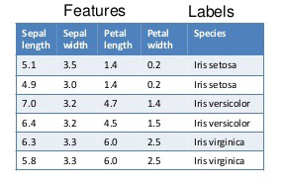
Overview of Machine Learning / AI Systems
Data
Model
Prediction
Supervised Learning:
Unsupervised Learning:
Clustering
Association

Slide 5

How it matters?
In digital age, human is impacted by decisions made by algorithmically-generated knowledge embedded within computers:
Scanning health risk factors
predicting insurance risk levels
automatically filtering job applicants
approving loans or credits
approving access to benefits schemes
personal profiling for surveillance and predicting risks of criminal
Fear of the unknown
(Clinciu and Hastie, 2019)

Slide 6
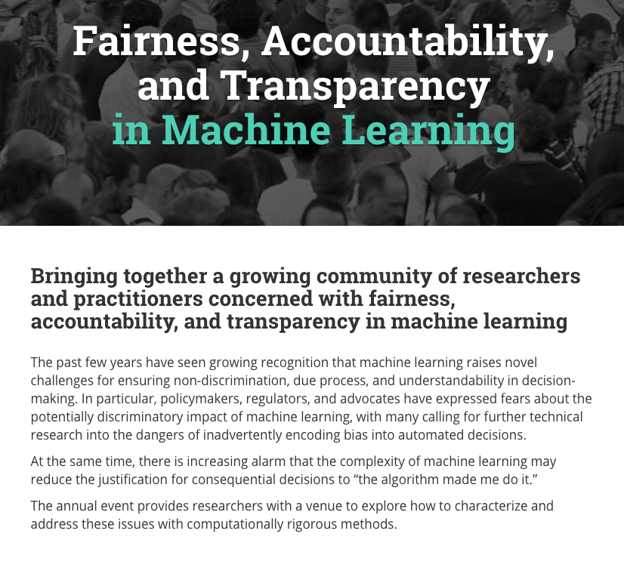
AI/Machine Learning within Social Contexts
Public norms concern: fairness, privacy, transparency, accountability…
Possible strategies
“traditional”: legal, regulatory, watchdog
Encapsulate social norms in data, algorithms, models
Fair machine learning
Data dependency
Privacy-preserving machine learning

Slide 7
Some Context: GDPR and Algorithmic Decision-Making
Article 22: Automated individual decision-making, including profiling, …,
prohibits any “decision based solely on automated processing, including profiling”
which “significantly affects” a data subject.
Profiling is “any form of automated processing of personal data consisting of the use of personal data to evaluate certain personal aspects relating to a natural person”
Perspective: Explainable algorithm if machine learning model can be articulated and understood by human.
Adequate explanation would provide accountability of how input features relate to predictions:
Likelihood of loan recommendation if the applicant is a minority?
Which features play the largest role in prediction?
B. Goodman and S. Flaxman, "European Union regulations on algorithmic decision-making and a 'right to explanation, Proc. 2016 ICML Work. Hum. Interpret. Mach. Learn. (WHI 2016), Jun. 2016.

Slide 8
Fairness

Slide 9
AI with Fairness Characteristics?
Imperfect statistical models are inherently inequitable, but are not necessarily systematically discriminatory
Oxford English Dictionary - Fairness is The quality of treating people equally or in a way that is reasonable.
Subjectivity concerns
Numerous mathematical definitions of fairness - some of them are contradictory
Anti-classification
Classification parity
Calibration
S Corbett-Davis and S Goel, The measure and mismeasure of fairness: A critical review of fair machine learning,” Arxiv, 2018.

Slide 10
Unfairness Occurrence
Data (input)
Inaccurate or insufficient data
Underrepresentation
Models (output)
Discriminatory treatment of subpopulations
build or “post-process” models with subpopulation guarantees
Not fully causally related variable that are correlated to the protected class
Algorithms (process)
learning algorithm generating data through its decisions
e.g. don’t learn outcomes of denied mortgages
lack of clear train/test division

Slide 11
Discrimination as Unfairness
Legal protection for Protected Classes
Typically includes race, color, religion, sex, disability, familial status, national origin, and age - depending on the law
Employment, credit, benefits and housing are targets of regulations
Types of Discrimination
Overt discrimination
Disparate treatment
Adverse impact or disparate impact

Slide 12
Describing Fairness: Anti-Classification
One may not use Protected Class status when making a decision (i.e., building a learning model)
This corresponds to "disparate treatment"
Use of protected class status does not have to be explicit: Proxies for class status
Proxies for Protected Class status
Complexity of the model leads to class membership being used to make decisions in a way that cannot easily be found and ameliorated.
If variables used in the model have a strong relationship with class status, spurious correlation or poor model building could lead to a proxy problem.
Anti-classification may cause discrimination

Slide 13
Describing Fairness: Classification Parity
Ensuring that common measures of predictive performance are equal across classes
Equalizing false positive and false negative rates
Differential validity
Examples of dangers when using classification parity:
Predatory lending
Increased crime in affected communities

Slide 14
Describing Fairness: Calibration
Model outcomes, conditioned on risk, are independent of Protected Class status
A calibrated model will predict that:
Protected Class members who have an estimated X% chance of defaulting truly default at a X% rate
Control class members who have the same estimated X% chance of defaulting truly default at the same X% rate

Slide 15
Less Discriminatory AI Models
Less discriminatory modeling: Focus on model fairness over social fairness
Same principles used to find viable less discriminatory models in traditional statistics can be used in Al models. Viable models are:
Similarly predictive
Have lower adverse impact
Are found through a "reasonable search"
Searching for alternatives in Al may take extra time.
However, advances in computing that have allowed Al to flourish also allow a more thorough search for alternatives

Slide 16
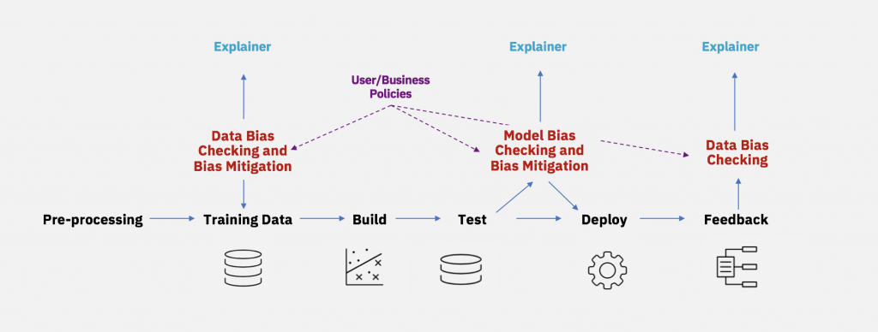
Less Discriminatory AI Models: Methods
Less Discriminatory Models may be found through:
Alternative feature selection: Smart searches, variable grouping, statistical methods
Adversarial modeling
Algorithm selection
Hyperparameter searches
Regularization
Data preprocessing
Open Source Fairness Programs: IBM's Al Fairness 360
Mitigating bias throughout the AI lifecycle

Slide 17
Privacy

Slide 18
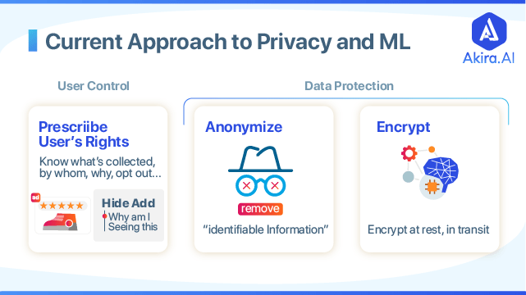

Slide 19
Privacy by Design
Organisation
Security
Legal
Required by GDPR
Technical scope
Engineering toolbox
Puzzle pieces - not complete solutions
Assuming:
Legal requirements
Security primitives
Process
Privacy
UX
Statistics
Culture
Architecture

Slide 20
Privacy by Design
Right to be forgotten
Limited collection
Limited retention
Limited access
From employees
In case of security breach
Consent for processing
Right for explanations
Right to correct data
User data enumeration
User data export

Slide 21
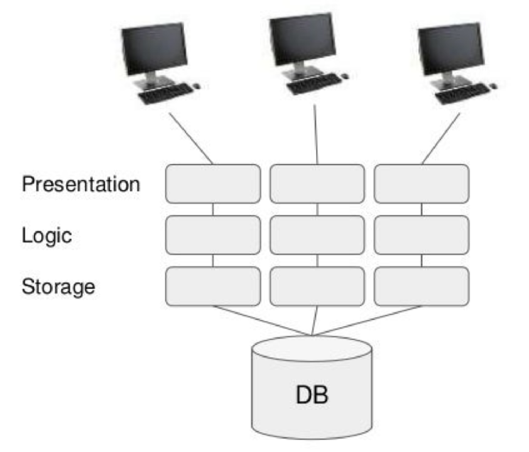
Traditional Data-Centric Systems
Monolith
All data in one place
Analytics and online serving from
single database
Current state, mutable
(Albertsson, 2018)

Slide 22
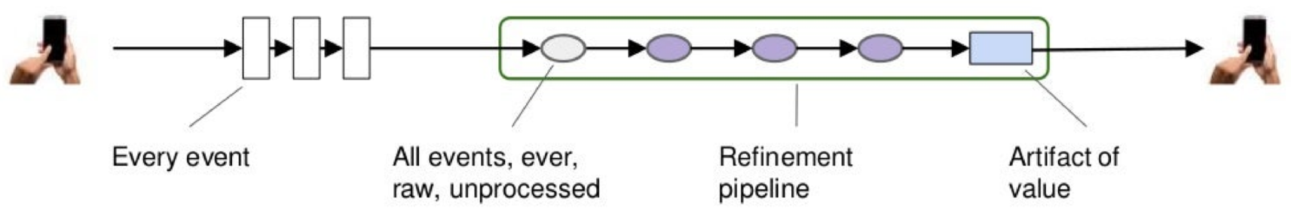
Big Data Systems
Rationales:
Emerging types of data-driven AI
Rapid product iterations
Data-driven feedback
Democratized data
Robustness for scaling up business logic
(Albertsson, 2018)

Slide 23
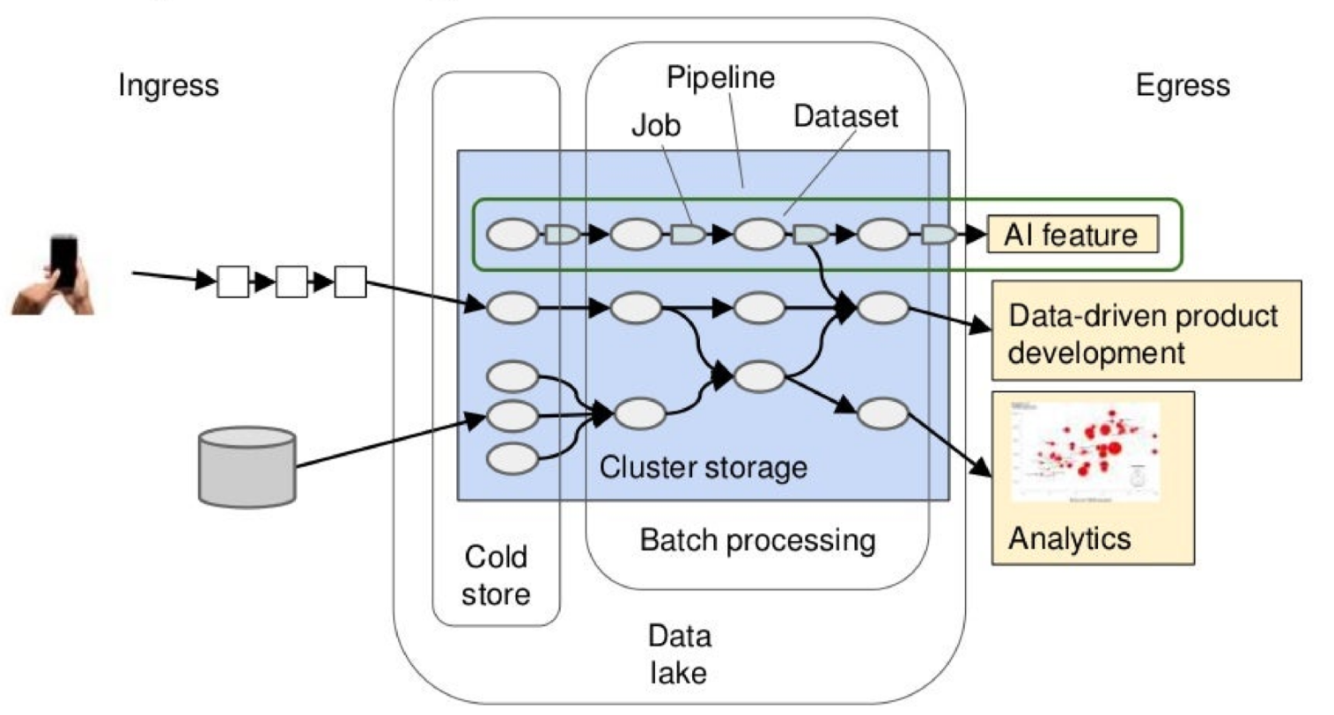
Data Processing at Scale
(Albertsson, 2018)

Slide 24
Personal information (PII) classification
Red - sensitive data
GPS location
Messages
Views, likes
Yellow - personal data
IDs (user, device)
Name, email, address
IP address
Green - insensitive data
Not related to persons
Aggregated numbers
Grey zone
Birth date, zip code
Recommendation / ads models?
A need of field/dataset classification
Is application content sensitive?
Music playlists - perhaps not
Running tracks, taxi rides - apparently
In-application messages - probably

Slide 25
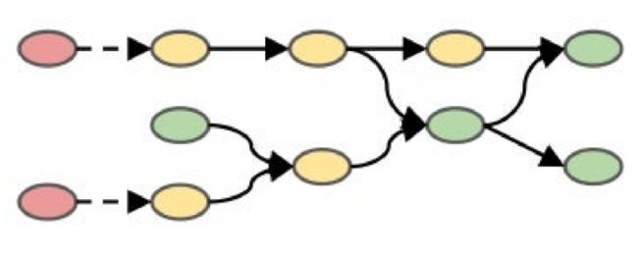
Possible Strategy: Privacy Protection at Ingress
Scramble/shuffle on arrival
Pros:
Simple to implement
Cons:
Limits value extraction
Deanonymisation possible
Adapted from (Albertsson, 2018)

Slide 26
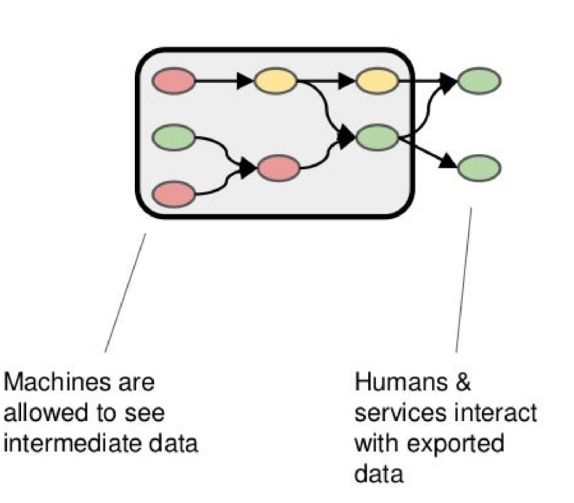
Privacy Protection at Egress
Pros:
Enabling processing in opaque box
Simpler to reason about
Cons:
Strict operations required
Exploratory analytics need explicit egress / classification
Adapted from (Albertsson, 2018)

Slide 27
Permission to Process
Processing personal data requires a sanction
Business motive is not sufficient
Explicit sanction
Consent from user
Necessary to perform core service
Implicit sanction
Required by regulations
Detect money laundry, fraud, abuse
Bookkeeping
Not exempt user
Not underage
No hidden identity
Towards oblivion: Pll data needs to be governed, collared, or discarded
Discard what you can

Slide 28
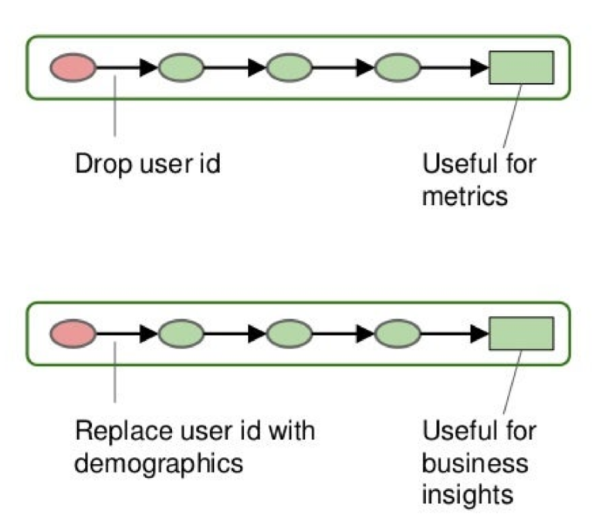
Discard: Anonymisation
Discard all Pll
User id in example
No link between records or datasets
Replace with non-PII
E.g. age, gender, country
Still no link
Beware: rare combination can lead to no anonymisation
Adapted from (Albertsson, 2018)

Slide 29
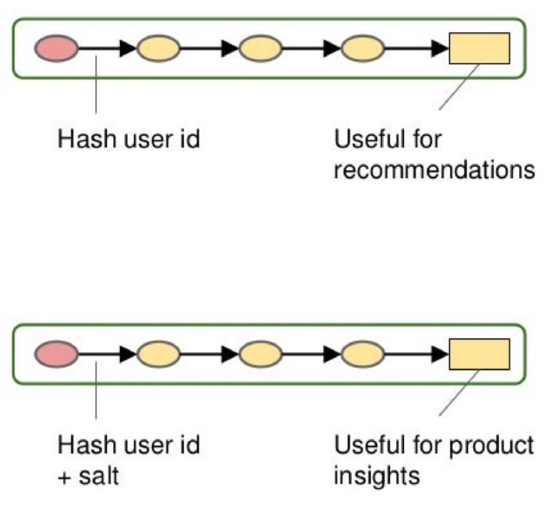
Partial Discard: Pseudonymisation
Hash Pll
Records are linked
Across datasets
Persons can be identified (with additional data)
Hash recoverable from Pll
Hash Pll + salt
Hash not recoverable
Records are still linked
Across datasets if salt is constant
Adapted from (Albertsson, 2018)

Slide 30
Data Model Deadly Sins
Using Pll data as key
Username, email
Publishing entity ids containing Pll data
E.g. user shared resources (favourites, compilations) including username
Publishing pseudonymised datasets
They can be de-pseudonymised with external data

Slide 31
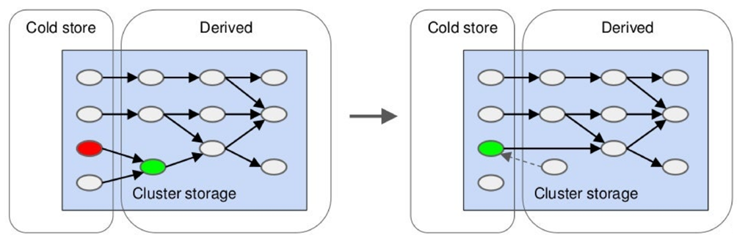
Lake Freeze
Remove expire raw dataset, freeze derived datasets
Workflow still works
Adapted from (Albertsson, 2018)

Slide 32
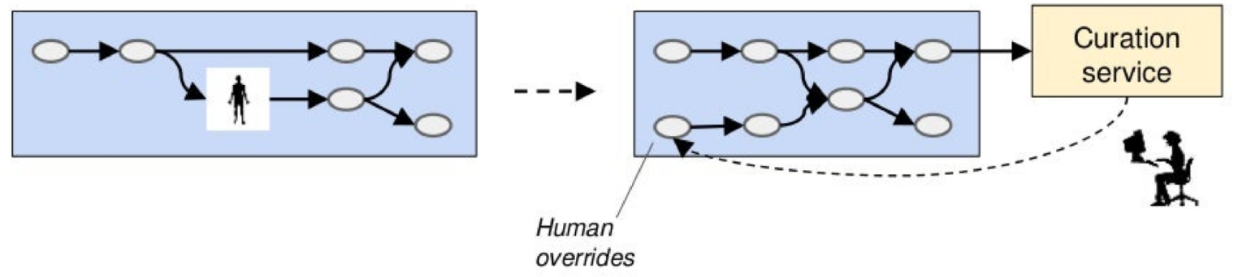
Correcting Invalid Data: Human in the Loop
Add human curation to cold store
Pipeline job merges human curation input
Overrides data from other sources
Adapted from (Albertsson, 2018)

Slide 33
Transparency

Slide 34
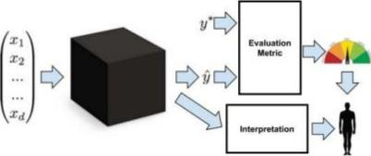
Interpretability of Machine Learning
Transparency
Are features understandable?
Which features are more important?
Post hoc interpretability
Natural language explanations
Visualisation of models
Domain-specific interpretation: "this tumor is classified as malignant because to the model it looks a lot like these other tumors"
Z. C. Lipton, "The Mythos of Model Interpretability," Proc. 2016 ICML Work. Hum. Interpret. Mach. Learn. (WHI 2016), Jun. 2016.

Slide 35
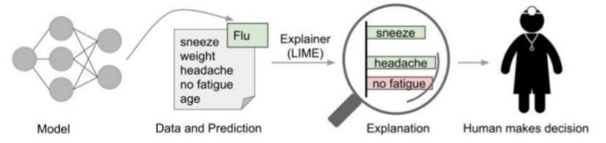
Interpretability: Why should it be trusted?
If the users do not trust a model or a prediction, they will not use it.
Explaining a prediction relates to presenting textual or visual illustrations that provide qualitative understanding of the relationship between the instance’s components and the model’s prediction.
M. T. Ribeiro, S. Singh, and C. Guestrin, "'Why Should I Trust You?' : Explaining the Predictions of Any Classifier," in Proceedings of the 22nd ACM SIGKDD International Conference on Knowledge Discovery and Data Mining - KDD '16, 2016, pp. 1135-1144.

Slide 36
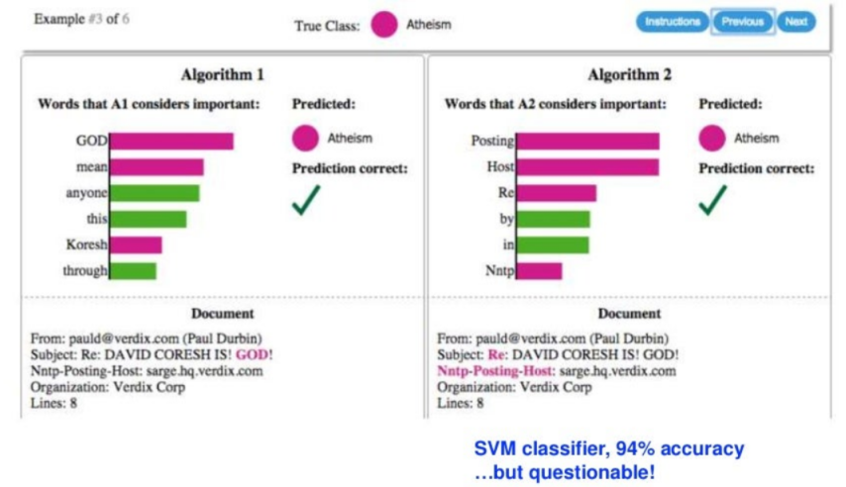
Features: High-Level
(Missier, 2018)

Slide 37
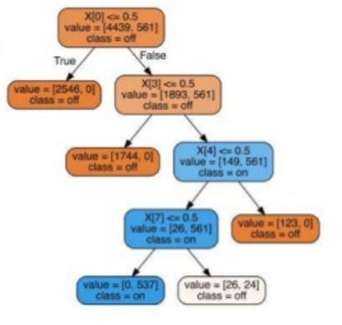
Features
Volume: how many features contribute to the prediction?
Meaning : how suitable are the features for human interpretation?
Raw: (low-level, non-semantic) signals such as images pixels
Deep learning
Many features versus Few, high-level features.
(Missier, 2018)

Slide 38
Law-Obeying AI
Operational Al systems need to obey both the law of the land and values
Why do we need oversight systems?
Al systems learn continuously, i.e., they change over time
Al systems are becoming opaque
"black boxes" to human beings
Al-guided systems have increasing autonomy
Make choices "on their own."
Development of Al oversight systems
A. Etzioni and 0. Etzioni, "Designing Al Systems That Obey Our Laws and Values," Commun. ACM, vol. 59, no 9 pp. 29-31, Aug. 2016.

Slide 39
AI Accountability
Asked where Al systems are weak today, Veloso (*) says they should be more transparent. "They need to explain themselves: why did they do this, why did they do that, why did they detect this, why did they recommend that? Accountability is absolutely necessary"
Gary Anthes. 2017. Artificial intelligence poised to ride a new wave. Commun. ACM 60, 7 (June 2017).
(*) Manuela Veloso, Head of the Machine Learning Department at Carnegie-Mellon University

Slide 40
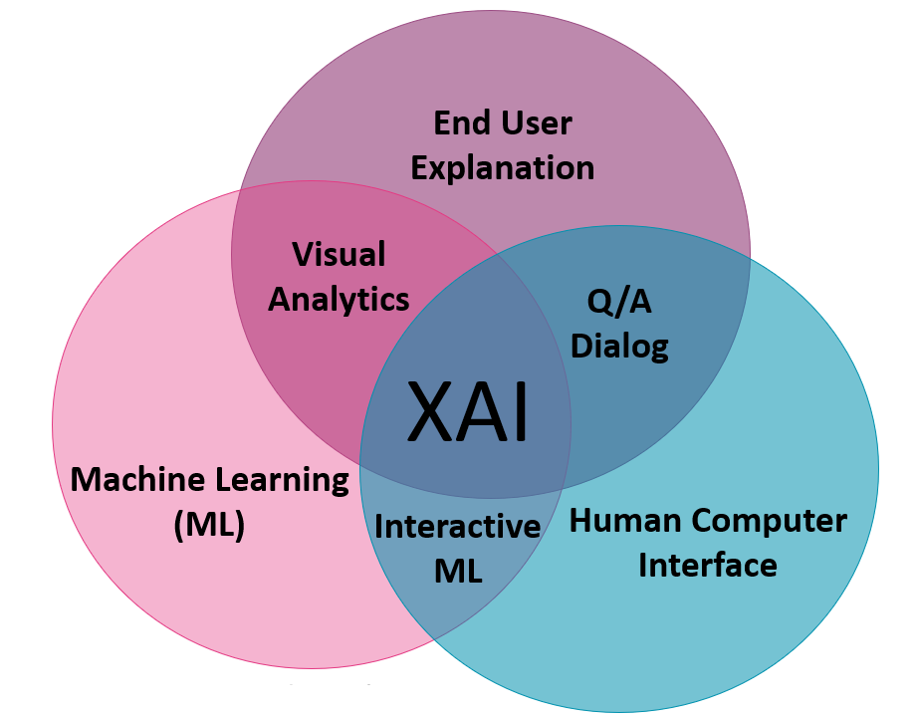
Explainable AI
“Explainable AI can present the user with an easily understood chain of reasoning from the user’s order, through the AI’s knowledge and inference, to the resulting behavior" [van Lent et al., 2004].
"XAI is a research field that aims to make AI systems results more understandable to humans" [Adadi and Berrada, 2018].
(Clinciu and Hastie, 2019)
M van Lent, W Fisher, and M Mancuso. 2004. An explainable artificial intelligence system for small-unit tactical behavior. In Proc. 16th conference on Innovative applications of artificial intelligence (IAAI'04), Randall Hill (Ed.). AAAI Press 900-907.
A Adadi and M Berrada. 2018. Peeking Inside the Black-Box: A Survey on Explainable Artificial Intelligence (XAI).IEEE Access, 6:52138–52160.

Slide 41
References
Gary Anthes. 2017. Artificial intelligence poised to ride a new wave. Commun. ACM 60,7 (June 2017), 19-21. DOI: httos://doi.org/10.1145/3088342
J. Burrell, "How the machine 'thinks': Understanding opacity in machine learning algorithms," Big Data Soc., vol. 3, no. 1, p. 2053951715622512,2016
Caruana, Rich, Lou, Yin, Gehrke, Johannes, Koch, Paul, Sturm, Marc, and Elhadad, Noemie. Intelligible models for healthcare: Predicting pneumonia risk and hospital 30-day readmission. In KDD, 2015
A. Etzioni and 0. Etzioni, "Designing Al Systems That Obey Our Laws and Values," Commun. ACM, vol. 59, no. 9, pp. 29-31, Aug. 2016.
Z. C. Lipton, "The Mythos of Model Interpretability," Proc. 2016 ICML Work. Hum. Interpret. Mach. Learn. (WHI 2016), Jun. 2016.
M. T. Ribeiro, S. Singh, and C. Guestrin, "'Why Should I Trust You?' : Explaining the Predictions of Any Classifier," in Proceedings of the 22nd ACM SIGKDD International Conference on Knowledge Discovery and Data Mining - KDD '16, 2016, pp. 1135-1144.
M van Lent, W Fisher, and M Mancuso. 2004. An explainable artificial intelligence system for small-unit tactical behavior. In Proc. 16th conference on Innovative applications of artificial intelligence (IAAI'04), Randall Hill (Ed.). AAAI Press 900-907.
A Adadi and M Berrada. 2018. Peeking Inside the Black-Box: A Survey on Explainable Artificial Intelligence (XAI).IEEE Access, 6:52138–52160.
https://arxiv.org/pdf/1609 05807 pdf
https://andv.org/pdf/1811.10154.pdf
https://arxiv.org/pdf/1802.04422.pdf

